Slide 1


Architectural configurations, atlas granularity and functional connectivity with diagnostic value in Autism Spectrum Disorder
Cooper Mellema
Alex Treacher, Kevin P. Nguyen, Albert Montillo
ISBI, April 2020
Notes:
@ Add the full author list under the title. Put your name in boldface.
Thank audience, present title and my name
@Mention you are part of a team, DLPH lab, at UTSW med center bioinformatics dept.

Slide 2
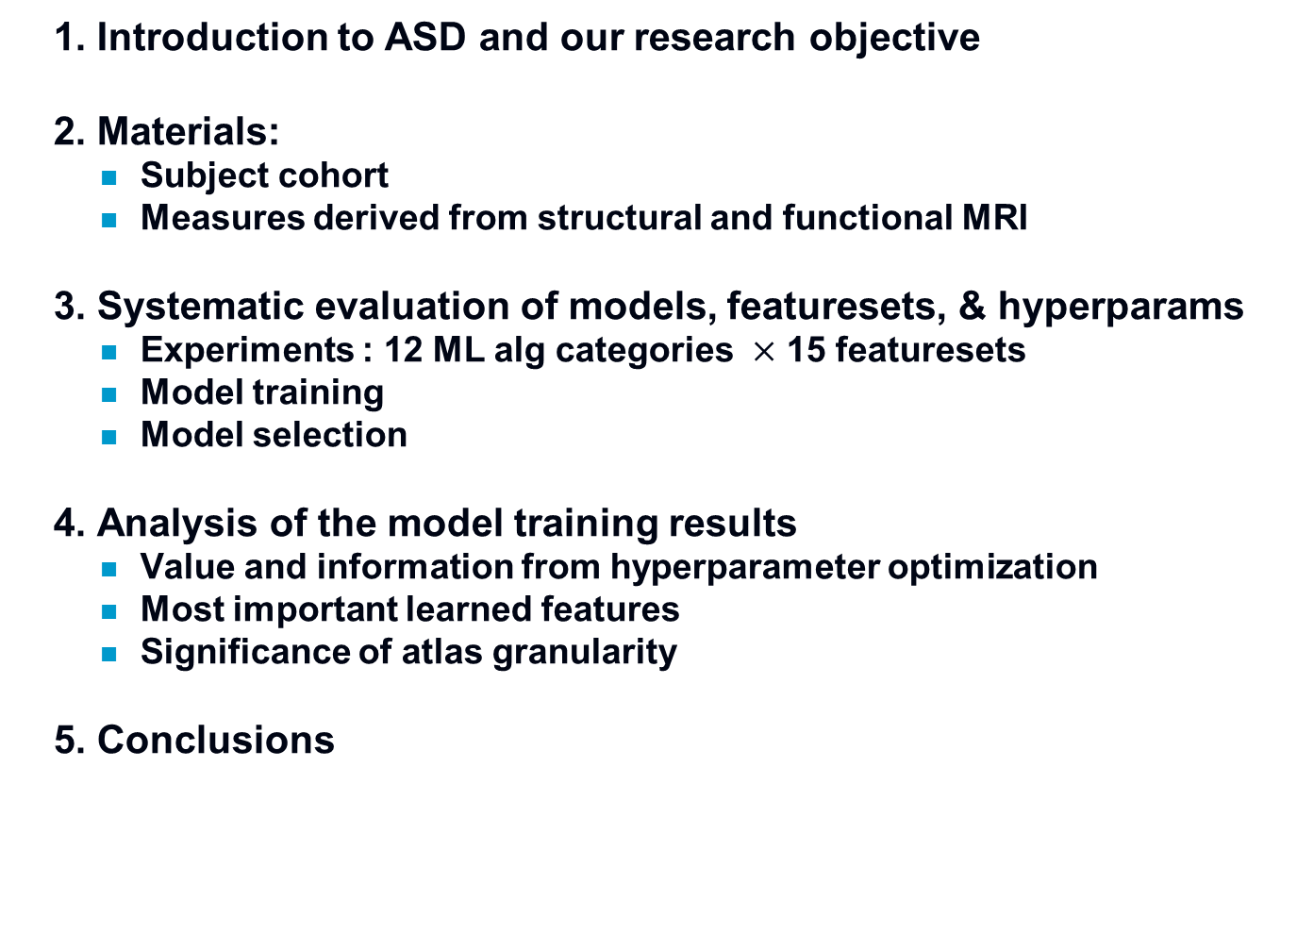
Outline
  1. Introduction to ASD and our research objective
  2. Materials:
    Subject cohort
    Measures derived from structural and functional MRI
  3. Systematic evaluation of models, featuresets, & hyperparams
    Experiments : 12 ML alg categories $×$ 15 featuresets
    Model training
    Model selection
  4. Analysis of the model training results
    Value and information from hyperparameter optimization
    Most important learned features
    Significance of atlas granularity
  5. Conclusions
Notes:
Sine my new work builds off of experiments presented at ISBI last year, I will briefly review those experiemnts here
@ This work is a detailed analysis of the data obtained in this systematic model training experiment.
Examining what has been learned:
*What does hyperparameter optimization reveal?
*What features did top models learn?
*How does the choice of atlas granularity impact results?
@The conclusion summary you had in this outline was for the previous presentation, if you say anything orally here it should reflect what you did for the current paper.

Slide 3
Autism Spectrum Disorder (ASD)
  Psychiatric disorder affecting 1 in 54 children¹
  Characterized by abnormal neurological development
  Currently diagnosis of ASD is:
    Based upon a evaluation of clinical symptoms and behaviors, which can be subjective.
    Accuracy of diagnosis dependent on skill level of the expert. These experts are not available at many clinics.
    The test can be multiple hours long.
    A more objective biomarker is of interest.
  Extensive evidence indicates that Autism impacts brain connectivity.
  Multi-contrast MRI: functional and structural MRI can non-invasively quantify anatomical and functional alterations in ASD.
  Motivation: Build a predictor to exploit these measures to:
    Inform diagnoses to make accurate objective diagnosis accessible
    Enable patients to get appropriate care, early in their development to reduce morbidity.
Notes:
(citation is the newer estimate based on newer criteria)

Slide 4
Challenges and our objective
  Challenges and open research questions
    Which type or combination of features types is optimal?
    Which ML model makes optimal predictions with MRI features?
    What are the characteristics of the optimized hyperparameters?
    What are the most important learned features?
      Are they neurobiologically interpretable?
    Are similar features learned across atlases and atlas resolutions?
  Objective
    Build a diagnostic model to predict Healthy Control (HC) vs ASD
      Using multi-contrast MRI data and machine learning.
      In order to inform diagnoses and make expert-level diagnosis more readily available and reproducible while reducing subjectivity
Notes:
@ I adjusted the list of challenges. Please review.

Slide 5
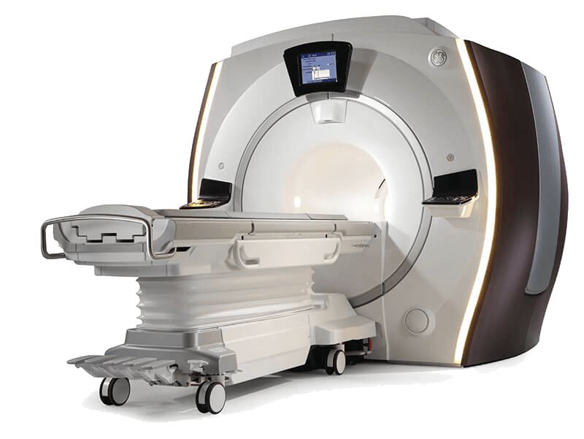
Materials
  915 subjects from the IMPAC dataset ¹
    sMRI and fMRI images rated ‘satisfactory’ quality by IMPAC
    418 ASD subjects, 497 healthy control (HC) subjects
    Age and gender matched
  Includes derived imaging features per ROI rather than raw images
    Features help ensure data remains non-identifiable; more readily shared
    Feature derivation will be described next
Parameter | Values
TR | 0.813 - 3.0 seconds
Scan time | ~6 min
Voxel resolution | 3x3x4 mm (resampled to 3mm isotropic)
5

Slide 6
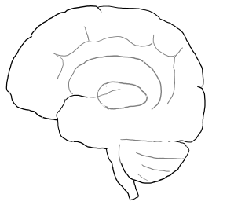
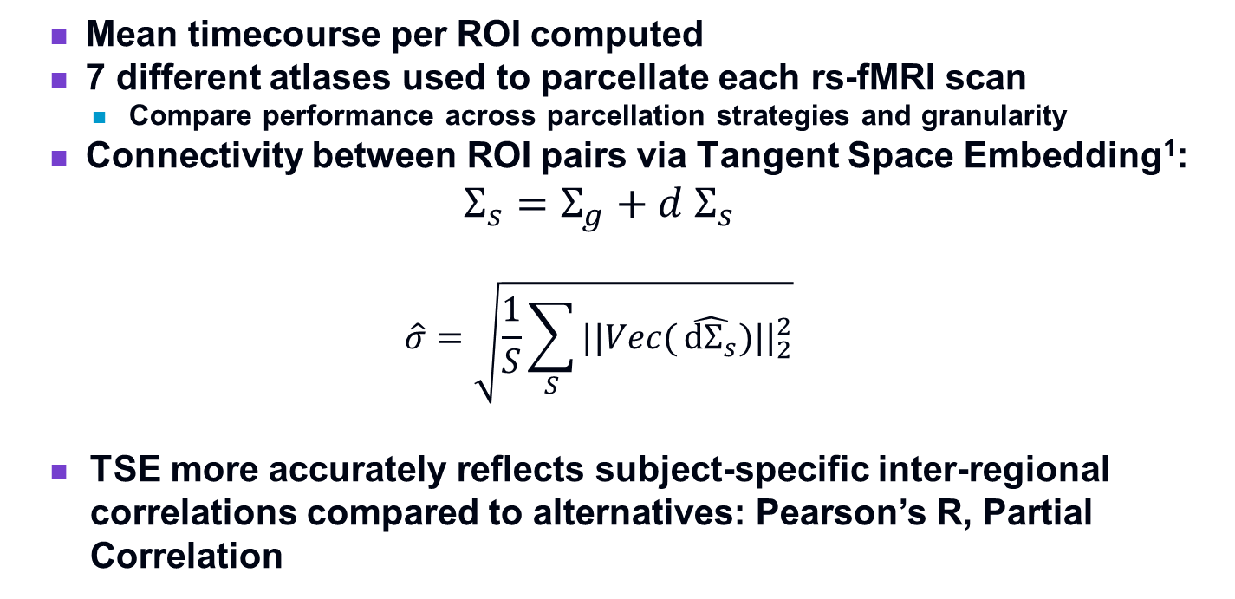
Materials: Measures derived from rs-fMRI
Resting state-fMRI activation timecourses
ROI Parcellation per Atlas
Tangent Space Embedding between mean ROI timecourses
Functional Connectivity Matrix
  Mean timecourse per ROI computed
  7 different atlases used to parcellate each rs-fMRI scan
    Compare performance across parcellation strategies and granularity
  Connectivity between ROI pairs via Tangent Space Embedding¹:
  $$Σ_{s}=Σ_{g}+d Σ_{s}$$
  $$\hat{σ}=\left.\sqrt{\frac{1}{S}\sum_{S}{||Vec(}\hat{{dΣ}_{s}})||_{2}^{2}}\right.$$
  TSE more accurately reflects subject-specific inter-regional correlations compared to alternatives: Pearson’s R, Partial Correlation
6
Notes:
Manifold = symmetric positive definite matrices
-EC is + and positive definite
The functional MRI data was parcellated into one of 7 different atlases and the TSE was used to calculate a functional connectivity score between the mean timecourses per ROI. TSE was chosen because it is a better reflection of subject-specific FC changes than other alternatives such as Pearson’s R and partial correlation
==============Mathematical clarification:==========================
The principal assumption in TSE is that the Group level covariance matrix and subject-specific covariance matrix are clustered in a high dimensional manifold (dimensions=number of features).$\hat{σ}$ is the maximum likelihood estimate of the isotropic variance between the Group level and subject specific covariance matrix. This is an NxN matrix that describes the distance between the Group level and subject specific covariance matrix in the high dimensional manifold
++++++++++++++++++details++++++++++++++++++++++++++++++++++++++++
Parcellation by one of seven atlases
Tangent space embedding between regions without thresholding
Tangent Space embedding:
$$Σ_{s}=Σ_{g}+d Σ_{s}$$
The subject’s covariance matrix is a sum of the group covariance and subject specific contributions
$$\hat{σ}=\left.\sqrt{\frac{1}{S}\sum_{S}{||Vec(}\hat{{dΣ}_{s}})||_{2}^{2}}\right.$$
Alternatives:
Pearson’s R
TSE used to more accurately temporally varying correlation across subjects
Math=too much for this?

Slide 7
Classical ML models and hyperparameters
  Shallow Nonlinear models evaluated:
  Shallow Linear models evaluated:
Naïve Bayes¹ | Random Forest² | Extremely Random Trees² | Adaptive Boosting³ | Gradient Boosting⁴ | SVM (RBF) Gaussian Kernel⁵
No hyperparameters Scikit-Learn | Number of Estimators: [50,5000] Max Nodes: [5,50] Scikit-Learn | Number of Estimators: [50,5000] Max Nodes: [5,50] Scikit-Learn | Number of Estimators: [20, 2000] Learning rate: [0.1, 0.9] Scikit-Learn | Number of Estimators: [5, 5000] Max depth: [1,10] Subsampling fraction per tree; [0.2,1] Learning rate:[0.01,1] Scikit-Learn | C: [0.0001,10000] Max iterations: [10000, 100000] Gamma: [0.01, 100] Scikit-Learn
SVM with Linear Kernel⁵ | Logistic Regression with Lasso Regularization | Logistic Regression with Ridge Regularization
C: [0.0001,10000] Max iterations: [10000, 100000] Scikit-Learn | C: [0.0001, 1000] Maximum iterations: [1000,10000] Scikit-Learn | C: [0.0001, 1000] Maximum iterations: [1000,10000] Scikit-Learn
Notes:
We tested a representative subset of ML models including:
6 shallow nonlinear ML models, including Random-Forest methods, boosting methods, and an SVM with a nonlinear kernel
And
<click>
3 shallow linear ML models including an SVM with a linear kernel as well as lasso and ridge regularized logistic regression. Regularized

Slide 8
Deep learning models and hyperparameters
Dense FeedFwd Network¹ | Bidirectional LSTM² Recurrent NN | Graph Convolu-tional NN BrainNetCNN ³
# hidden layers: [1,3] Layer width: [16, 256] Dropout fraction: [0.1, 0.6] L2 regularization: [0.0001, 0.02] | # hidden Layers: [1,3] Layer width: [16, 256] Dropout fraction: [0.1, 0.6] L2 regularization: [0.0001, 0.02] | # hidden layers: [0,2] Layer width: [16, 64] Dropout fraction: [0.1, 0.6] ReLU slope: [0.1, 0.5]
  Optimizer: Nesterov ADAM
  Batch Size: 128
  Early stopping
  Binary cross-entropy loss
Notes:
The deep learning models we tested included a dense feed fwd network, a bidirectional LSTM, and a graph-convolutional network. We searched over a small number of hidden layers, a layer width from 16 to 256, a varying dropout fraction, and varying amounts of L2 regularization.
Again the goal here is for similar levels of optimization across both the DL models and shallow ML models.

Slide 9
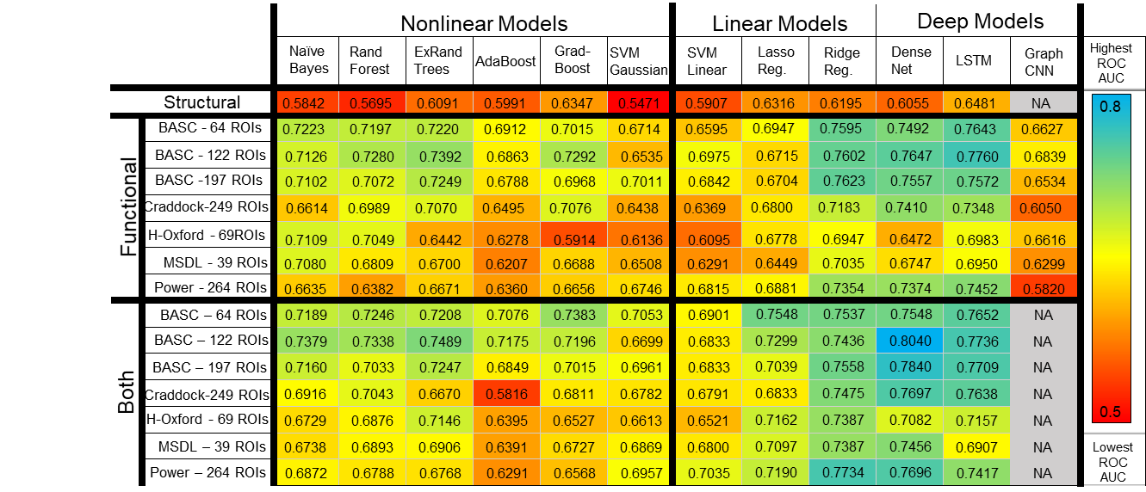
Results 1: Area under ROC for predicting ASD vs HC
  In table, model categories are shown from left to right
  Feature sets used are shown in the rows from top to bottom
  AUROC ranges from 0-1. Higher numbers are better. Colorbar on righthand margin.
Atlas
Notes:
‘structural’ != heading
The next several slides will use the same large table. To orient you,…

Slide 10
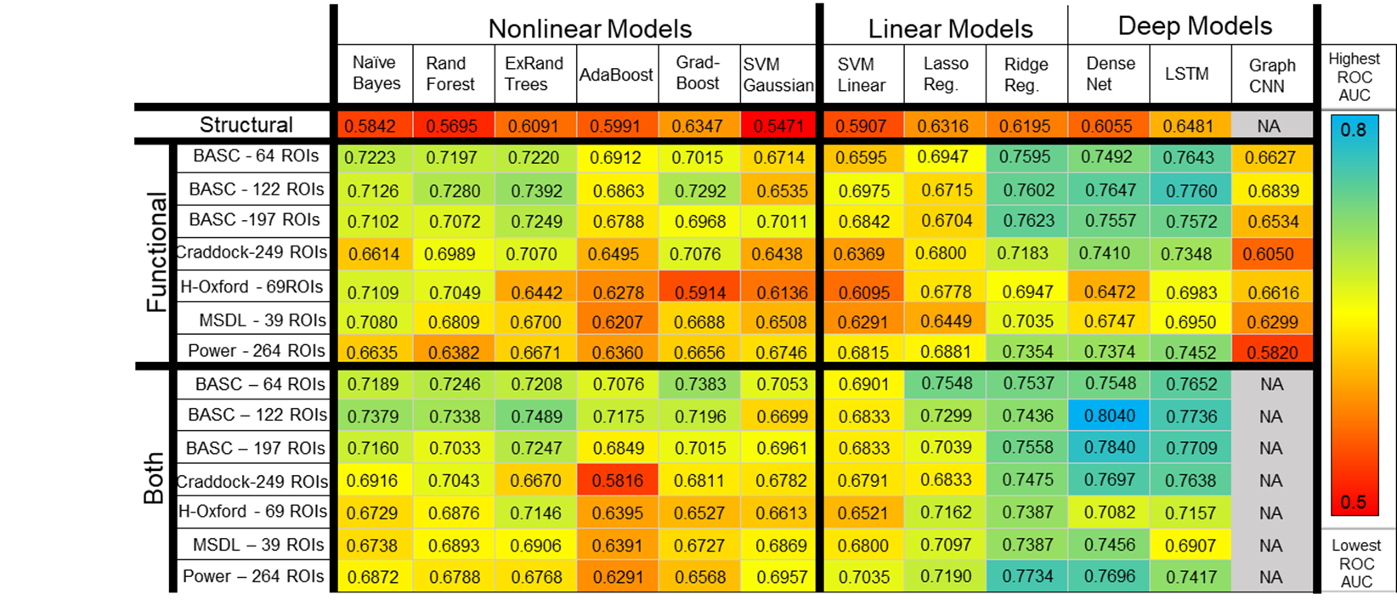

Results Continued: High performing models
Lin.
Notes:
Perf=Test
As I have presented these results before, Rather than comparing across groups in the table we are going to zoom in on and focus on the highest performing models

Slide 11
Comparisons with other work
  80.4 % AUC compares to mean of the top of IMPAC challenge entrants reported at MICCAI 2018: (79+/-1% ROC AUC)
  Compares favorably to reported results on imaging data (ABIDE) which achieved up to 73.3% AUC.
Author | Input | Features | Methods | Clases | Results
Mellema et al., ISBI 2019 | Rs-fMRI and sMRI | FC (TSE) and volumetry Multiple atlases | (Described above) | ASD v HC | 80.4% ROC AUC
Parisot et al:, 2018 | Rs-fMRI, ABIDE | FC (Pearson’s R) Single atlas | CNN – Grid Search | ASD v HC | 70.4 % accuracy
Meenashki et al:, 2018 | Rs-fMRI, ABIDE | FC (Pearson’s R) Multiple atlases | CNN – Random Search | ASD v HC | 73.3% accuracy
Top IMPAC Challenge Models, 2018 | Rs-fMRI and sMRI | FC (TSE) and volumetry Multiple atlases | Varied | ASD v HC | 79+/-1 % ROC AUC in top 10 methods
Our
Model
11
Notes:
80.4 % AUC compares to mean of the top of IMPAC challenge entrants reported at MICCAI 2018: (0.79+/-0.01 ROC AUC)
%Compares favorably to other top models from the literature using deep learning models such as CNNs from imaging data (ABIDE) which achieved up to 73.3% classification AUC.

Slide 12
Model Training Results
  Hyperparameter search results
    Were the search ranges sufficiently broad to isolate local performance configuration maxima?
    Which hyperparameters lend themselves to high performing diagnostics?
  Learned Features
    What are the most important learned features?
      Are they neurobiologically interpretable?
      Are these features novel or previously implicated?
      Are similar features learned across atlases & atlas resolutions?
  Strategy: cross-resolution analysis
    Hyperparameter analysis through density estimation
    Permutation feature importance
Notes:
Paraphrased whole slide
Reveal what was learned from the hyperparameter search
Reveal what was learned by the top models
Visualize the learned in formation across multiple atlases and resolutions.
4. Analysis of the model training results
Value and information from hyperparameter optimization
Most important learned features
Significance of atlas granularity

Slide 13
Results Continued: Best models using BASC
Lin.
  *
  *
  -best
  overall
  model
Notes:
And even more, I will be focusing on these three models using the BASC Atlas, a simple dense Feed forward network, and a varying number of Regions.
$ Note these are not multiresolution models. Instead you are investigating what was learned across 3 models each trained upon a distinct (single) resolution

Slide 14
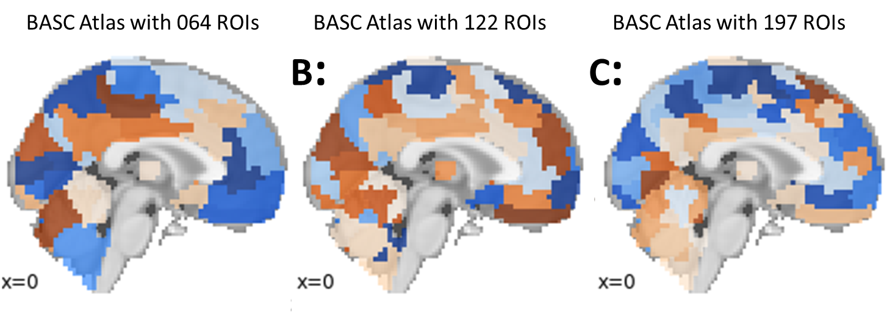
Multiresolution Comparison
  Top performing atlas: BASC
    Regions defined by resiliency of clustering with repeated subsampling
    3 resolutions were compared
Atlas | Performance (AU-ROC)
BASC – 64 Regions | 0.75
BASC – 122 Regions | 0.80
BASC – 197 Regions | 0.78
Notes:
Bootstrap analysis of stable clusters (NCUTS clustering)
Stability criterion = silhouette criterion using the full data (no samples removed) as reference
(Number of regions chosen with MSTEPS algorithm, which chooses a set of scales to explain 95% of the energy present in the singals)
The BASC atlas was defined by repeated clustering and subsampling, with the defined clusters being resilient to changes upon subsampling of the data the cluster was generated from.
Furthermore, the BASC atlas was used at 3 resolutions: a 64 region parcellation, a 122 region parcellation, and a 197 ROI parcellation. Connectivity data from all of these parcellations created high performing models with AU-ROC of 75, 80, and 78 % respectively. Something further to note is that more granular parcellations are not merely subdivisions of coarser atlas regions (ex in circles)

Slide 15
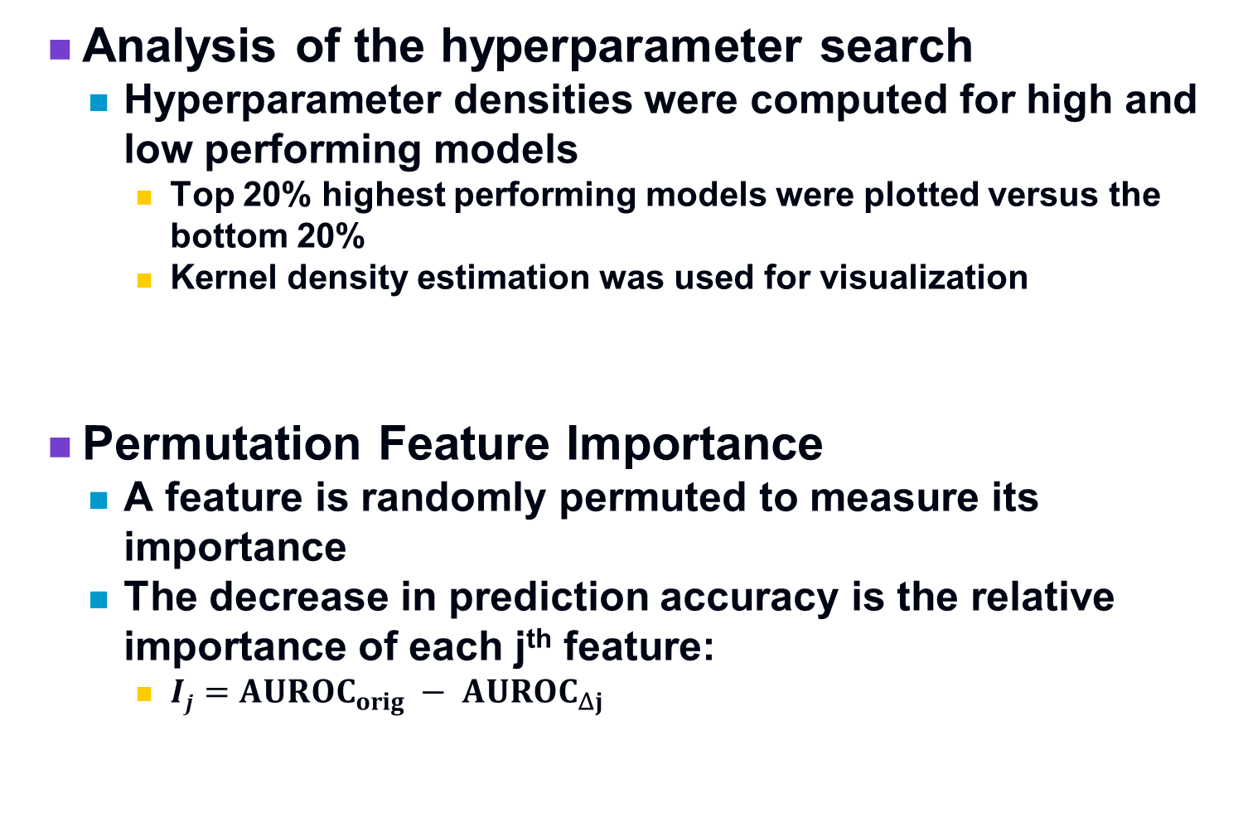
Methods:
  Analysis of the hyperparameter search
    Hyperparameter densities were computed for high and low performing models
      Top 20% highest performing models were plotted versus the bottom 20%
      Kernel density estimation was used for visualization
  Permutation Feature Importance
    A feature is randomly permuted to measure its importance
    The decrease in prediction accuracy is the relative importance of each j^{th} feature:
      $Ij=AUROC_{orig} − AUROC_{Δj}$
Notes:
$ density and not ranges were plotted for the high and low performing models.
@ I_j is the feature importance of the jth feature. AUROC of original data – AUROC with just the jth feature permuted.

Slide 16
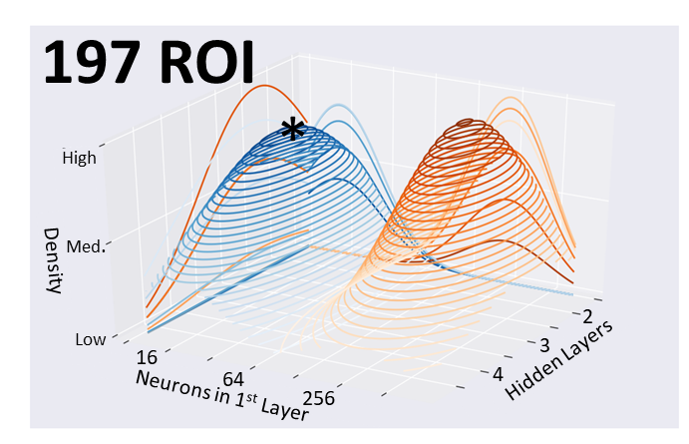
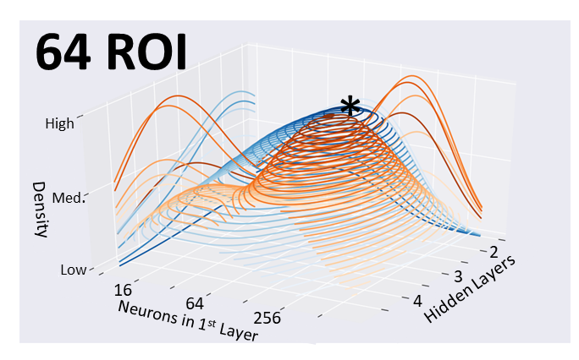
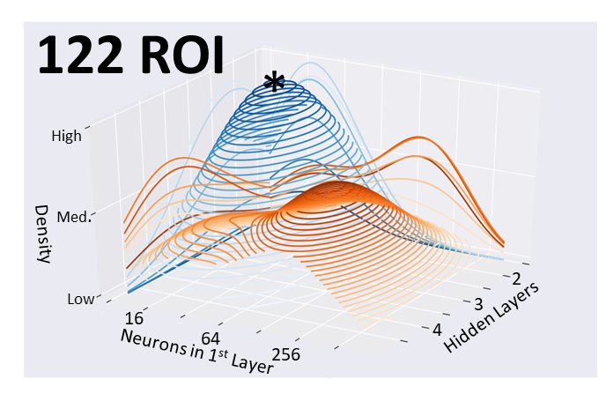
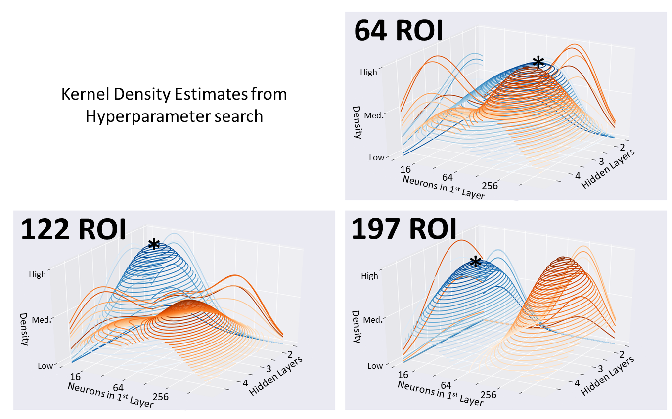
  Analysis of the hyperparameter search
  KDE’s for hyperparameter ranges of high performing models (blue) versus low perfoming models (orange)
Notes:
Take time and orient audience
-explain KDEs more
-introduce axes and colors
-Could also imagine plotting performance at each point tested
(not deterministic, but is probabilistic)

Slide 17
Assessment of hyperparameter search:
  Adequate search ranges were used:
    Values for high performing models lay towards the center of the search ranges and did not abut edges of search space.
  Different configurations were found between high and low performing models
    I.E. the orange (low performing) and blue (high performing) peaks didn’t substantially overlap
  Results show the highest performing models use:
    between 2-4 hidden layers
    Between 16-64 neurons per layer,
    Exact parameter is granularity dependent.
Notes:
@i.e. is lower case , fix throughout
$ Last purple bullet is a bit weak: rephrase as shown to emphasize what is in common ( I quote your ISBI abstract here)

Slide 18
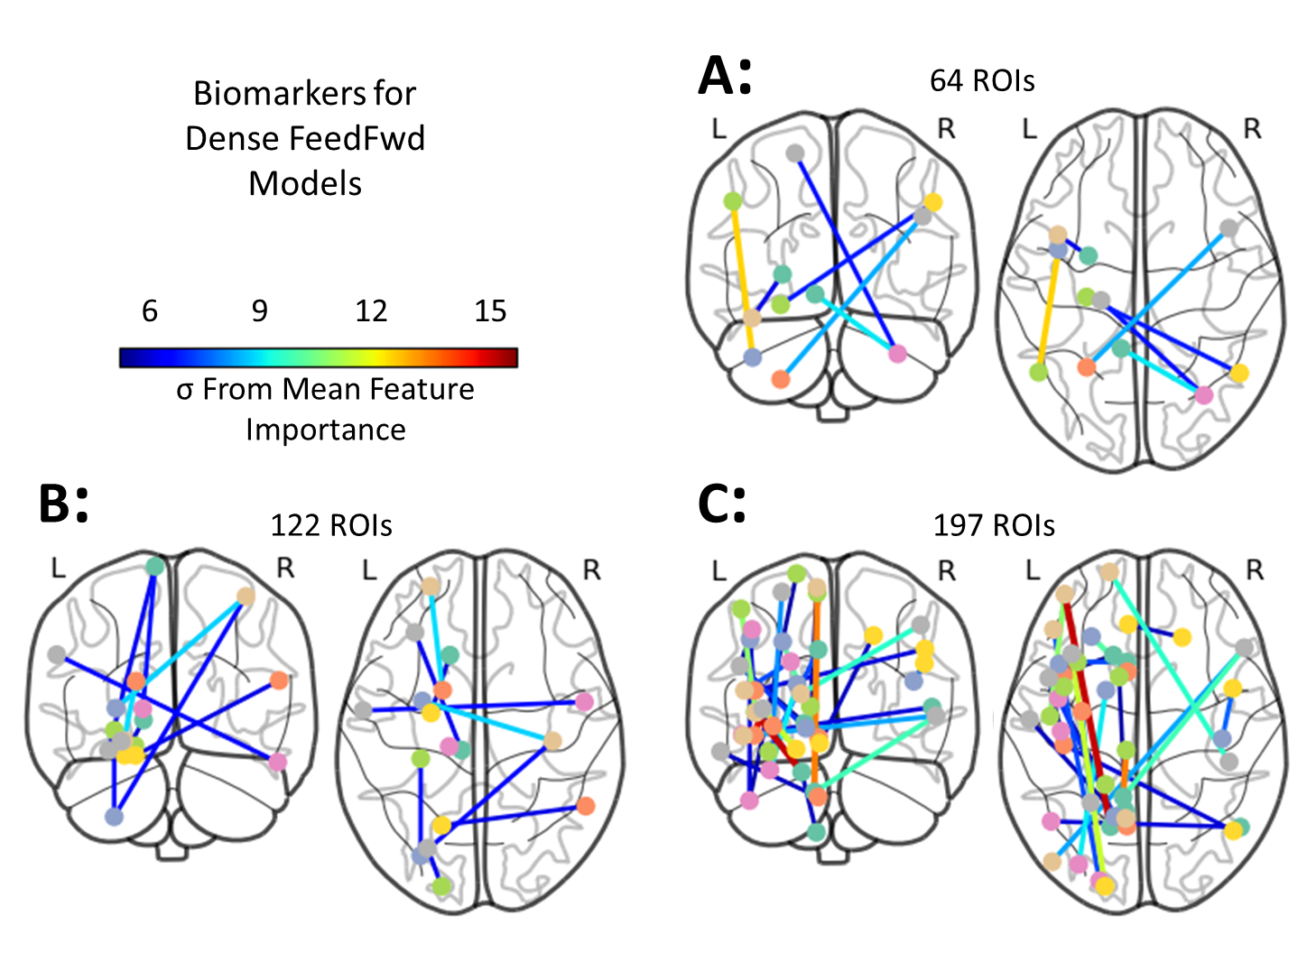
Permutation Feature Importance
  Using PFI, feature importances of the top model for each atlas are depicted in glass-brain views below
Notes:
“To aid in the comparison of IMPAC con-
nectivity features to the literature which often reports results
in Brodmann areas (BA), the centroid of each ROI for each at-
las was calculated and matched to the corresponding BA for
cross-study comparison. The ROI-ROI connection can then
be re-written as the closest BA-BA connection.”
The anatomical location of features with a z-score≥6 are
shown in Fig. 4. There is substantial overlap in the features
with high importance across all levels of granularity tested.”
These ==putative biomarkers
which emphasizes what is in common. This is central to your results. Features that appear across levels bolster confidence.
Name 2-3 common features SHARED across the levels.
Supplementary motor regions were involved in 11 FC
features across all three models, the posterior cerebellum is
involved in 8 FC features, and language association cortex
(BA 39) and secondary visual cortex (BA 19) are involved in
6 FC features across all three models
Uncommon:
preponderance of features shift from
Then point out that are some minor differences which is expected.
$ This sounds too obvious so I would omit this: These differences doesn’t necessarily mean that one is ‘better’ or ‘worse’ than another. The Features apparent at different resolutions are apparent as a function of scale and granularity, at microscales some features are lost, while at meso and macro scales new features become apparent while the microscale features get washed out

Slide 19
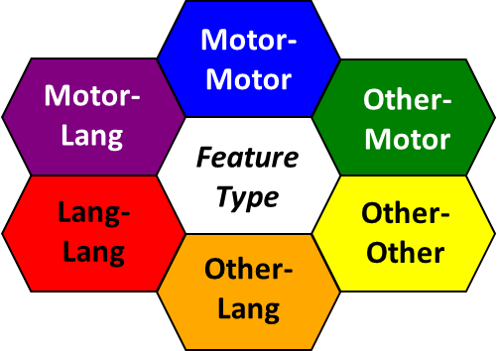
Learned features across atlases
  Functions of identified regions
    The top 15 features (by z-scored importance) will be depicted in a color-coded bar graph
    Color-coded by type of region connected
Motor-Motor
Motor-Lang
Other-Motor
Feature Type
Lang-Lang
Other-Other
Other-Lang
Notes:
Here we delve deeper into the functions of the nodes depicted in the previous figure.
An alternative view which highlights more the relative contribution of the features is shown here.
“Each feature is the functional connectivity be-
tween two brain regions and is given a distinct color based
on the function of these regions. Connections between senso-
rimotor ROIs are shown in blue, while connections between
language ROIs are in red. Connections between regions that
are neither motor nor language are in yellow [this consists primarily of association cortex]. A connection
between language (red) and motor (blue) ROIs is shown with
an intermediate hue (i.e. purple) and similarly for other region
function combinations.”

Slide 20
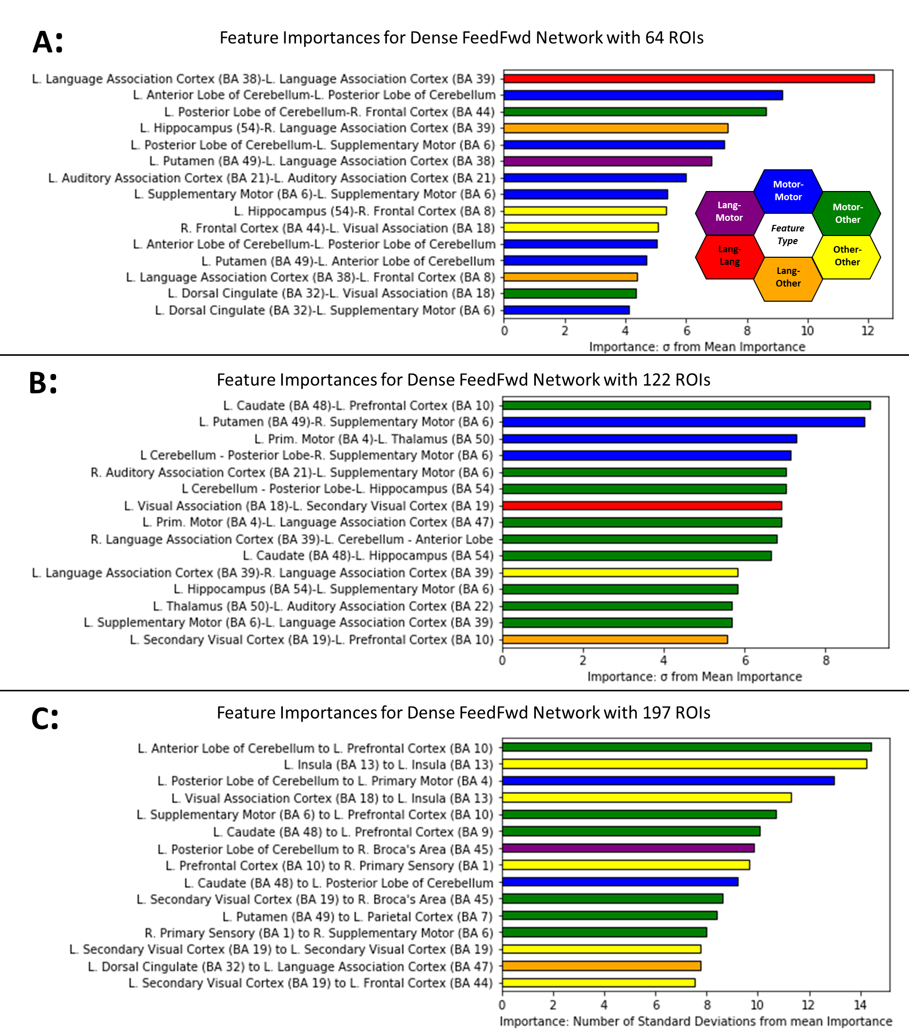
Learned features and interpretation
  Features that corroborate previously reported alterations in ASD:
    Motor and supplementary motor connections
      Possibly related to sensory processing alterations in ASD
  Novel features identified:
    Cerebellar features
Notes:
@ Emphasize the results in 2020 ISBI over 2019 ISBI.. Take a stab at the interpretation
@Add candidate neurobiological interpretation
The three most important features for the DenseFFwd
model trained from 64 ROIs were within the left language
association cortex, within the left cerebellum, and between the frontal cortex and cerebellum.
$ Highlight the features in this slide that are in agreement with alterations reported previously:
“Many of the features identiﬁed here are in agreement with
alterations reported previously including the signiﬁcantly al-
tered DMN connectivity, [9, 10, 11], connectivity in visual
areas[12, 11], [12, 13, 14], motor and supplementary motor
connectivity[13], connectivity in somatosensory association
areas[15, 14], and connectivity in the prefrontal cortex[15, 9,
10] in individuals with ASD.”
$ Highlight the novel findings (connections to the Cerebellum)

Slide 21
Learned features and interpretation
  Features that corroborate previously reported alterations in ASD:
    Motor and language features are identified more predominantly
      Both sensory processing and language processing are known to be involved in the pathophysiology of ASD
  Novel features identified:
    Cerebellar, again
Notes:
@Add candidate neurobiological interpretation
$ Add: For the model trained using the medium-grained atlas (122 ROIs),
the top 3 features were between motor regions and the pre-
frontal cortex, and two within motor cortex alone.
$ Highlight the features in this slide that are in agreement with alterations reported previously:
“Many of the features identiﬁed here are in agreement with
alterations reported previously including the signiﬁcantly al-
tered DMN connectivity, [9, 10, 11], connectivity in visual
areas[12, 11], [12, 13, 14], motor and supplementary motor
connectivity[13], connectivity in somatosensory association
areas[15, 14], and connectivity in the prefrontal cortex[15, 9,
10] in individuals with ASD.”
$ Highlight the novel findings (connections to the Cerebellum)

Slide 22
Learned features and interpretation
  Features that corroborate previously reported alterations in ASD:
    Preponderance of important feature types shifts more towards association cortex
  Novel features identified:
    Altered insular cortex connectivity
Notes:
Add candidate neurobiological interpretation
Add: For the
ﬁne-grained atlas (197 ROIs), the top three features were
between motor regions and the prefrontal cortex, within the
insula, and between motor regions.
Highlight the features in this slide that are in agreement with alterations reported previously:
“Many of the features identiﬁed here are in agreement with
alterations reported previously including the signiﬁcantly al-
tered DMN connectivity, [9, 10, 11], connectivity in visual
areas[12, 11], [12, 13, 14], motor and supplementary motor
connectivity[13], connectivity in somatosensory association
areas[15, 14], and connectivity in the prefrontal cortex[15, 9,
10] in individuals with ASD.”

Slide 23
Impact of atlas resolution on features learned:
  Consistently important features across atlas resolutions:
    supplementary motor regions (BA 6) implicated in 11 features
    posterior cerebellum implicated in 8 features
    language association cortex (BA 39) implicated 6 times
    secondary visual cortex (BA 19) implicated 6 times
    left anterior cerebellum implicated 5 times
  Differences across resolutions:
    Shift in preponderance of features
      Low resolution, motor features predominated
      Medium resolution, motor and language features predominated
      High resolution, association features increased
Notes:
@ A multiresolution feature is one that incorporates information from multiple resolutions simultaneously. You don’t have that here. Instead you are comparing the impact of atlas res on learned features.
***Nonmotor->association
$ Do not these points below. Instead I put a one line bullet on slide 37 “Look forward…”
Going forward more (new slide?) / multiresolution (don’t mention this)
Mention more is coming (you can mention a journal paper is in submission )
External data (this is Work-in-progress and unpublished so don’t give it away).
Supports multiscale approaches, but doesn’t yet show synergy (don’t mention at this time)

Slide 24
Limitations of this study
  Dataset provided only binary diagnosis
    ASD is a spectrum disorder
    Dataset with finder diagnostic gradations would enable training a more precise diagnositic model and may reveal additional biomarker insights.
  Other methods beyond PFI should be applied
    e.g. layer-wise relevance propagation
    To further explore learned abstractions
  While the dataset is intrinsically multisite, validation upon multiple datasets would be further confirmatory

Slide 25
Conclusions
  Through a systematic search across a wide variety of combinations of feature types x models categories,
    with an embedding of a unbiased hyperparameter optimization for each combination
    Allowed the construction of a predictor with state-of-the-art performance
  Mining the data from the hyperparameter optimization reveals that architectural configurations which lead to high performing deep learning diagnostic models for ASD used between 2-4 hidden layers with 16-64 neurons per layer.
    Optimal number of layers increased with atlas granularity
    Optimal number of neurons/layer decreased with granularity
  Deep learning identified new biomarkers
    identified new regions, such as connectivity to the anterior and posterior cerebellum, hold diagnostic importance.
    That these regions are overlapping across 3 atlas granularities bolsters confidence that the DL models discovered true discriminative features that may generalize well to new dataset and the clinic.
Notes:
$ work this into the bullets above
“The altered FC between the cerebellum and frontal and sensorimo-
tor cortices as a marker of ASD has received little attention in
the literature, as the cerebellum is often not included in func-
tional analyses. We suggest that these connections are areas
worthy of further investigation and research.”
$ practice this slide, Albert rewrote it from paper
AAM: are any of the features and good hyper parameters now also part of your conclusions?

Slide 26
Conclusions
  Deep confirmed previously implicated biomarkers
    Confirmed importance of multiple brain connections previously associated with social and sensory processing in ASD.
    Connectivity to the language association cortex and to the supplementary motor gyrus
  Parcellations with mid-range granularity (122-197 ROIs) performed better than those with coarser or more granular ROIs
    This suggests the scale or granularity of neuroimaging-detectable changes in functional connectivity in ASD.
    However each resolution captures different aspects of ASD which is supportive of future multiscale approaches
  Look forward to extending this work with further development to additional regions, testing and clinical translation. Paper in development.
Notes:
$ practice this slide, Albert rewrote it from paper
AAM: are any of the features and good hyper parameters now also part of your conclusions?

Slide 27











Acknowledgements
  Prof Albert Montillo
  Dr. Son Nguyen
  Cooper Mellema
  Kevin Nguyen
  Alex Treacher
  Krishna Chitta
  Dr. Zhiguo Shang
  Vyom Raval
  Contact Email: Cooper.Mellema@UTSouthwestern.edu
Funding:
NIH F31-NS115348
Lyda Hill Foundation

